Slide 1
RESEARCH PROPOSAL DRAFT

Slide 2
OVERVIEW
Title
HYDRO-MECHANIC MODELING OF THERMALLY INDUCED FRACTURES
Research question
Q1: How thermally induced fractures affect reservoir drainage, storage capacity and safety?
Hypotheses
H1: Thermally induced fracture dynamics affect reservoir drainage, fluid storage, and operational integrity.
H2: Natural fractures and rock failure in shear are mechanisms to release the strain energy resulting from thermal stresses
H3: Simple linear fracture transmissibility models using pressure and temperature as independent parameters are sufficient to capture the effective physical behavior needed to estimate reservoir drainage and fluid storage for most cases. However, the assessment of integrity needs to incorporate more complex physics.

Slide 3
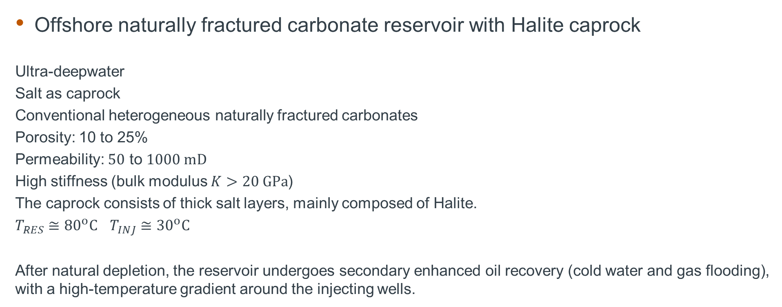
TARGET APPLICATION
Offshore naturally fractured carbonate reservoir with Halite caprock
Ultra-deepwater
Salt as caprock
Conventional heterogeneous naturally fractured carbonates
Porosity: 10 to 25%
Permeability: $50$ to $1000 mD$
High stiffness (bulk modulus $K>20 GPa$)
The caprock consists of thick salt layers, mainly composed of Halite.
$T_{RES}≅{80}^{o}C$ $T_{INJ}≅{30}^{o}C$
After natural depletion, the reservoir undergoes secondary enhanced oil recovery (cold water and gas flooding), with a high-temperature gradient around the injecting wells.

Slide 4
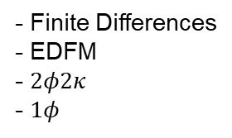
Methodology
Mechanics
Stress
Global mechanics
(U_{i})
Hydraulic
(P, S_{w}, S_{o}, S_{g})
P
- Finite Element
- Smeared
- Finite Differences
- EDFM
- $2φ2κ$
- $1φ$
Bound. Cond.
Fracture
Plasticity
(P, U_{i})
Effective params
T
P
Fracture propagation
(P, U_{i})
T
Thermal
(T)
- Finite Element
- Smeared
- Discrete
- Finite Differences

Slide 5
Methodology
Mechanics
Stress
Global mechanics
(U_{i})
Hydraulic
(P, S_{w}, S_{o}, S_{g})
P
- Finite Element
- Smeared
- Finite Differences
- EDFM
- $2φ2κ$
- $1φ$
Bound. Cond.
Fracture
Plasticity
(P, U_{i})
Effective params
T
P
Fracture propagation
(P, U_{i})
T
Thermal
(T)
- Finite Element
- Smeared
- Discrete
- Finite Differences

Slide 6
Methodology
Mechanics
Stress
Global mechanics
(U_{i})
Hydraulic
(P, S_{w}, S_{o}, S_{g})
P
- Finite Element
- Smeared
- Finite Differences
- EDFM
- $2φ2κ$
- $1φ$
Bound. Cond.
Fracture
Plasticity
(P, U_{i})
Effective params
T
P
Fracture propagation
(P, U_{i})
T
Thermal
(T)
- Finite Element
- Smeared
- Discrete
- Finite Differences

Slide 7
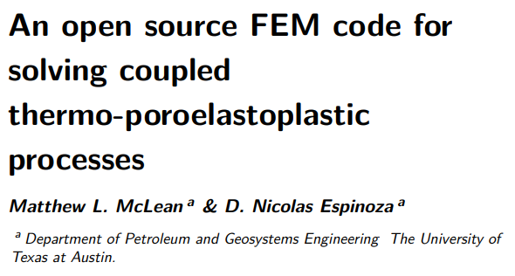
Implement plasticity solver
Plasticity
(P, U_{i})
Starting point: (McLean, 2024)
Re-implement and validate under libmesh (?)
Faster C++ implementation
Consider Enriched-Galerkin (Lee&Wheeler,2016)
Consider postprocessing filtering (Murad, 1994)
Apply to our target case (reservoir)
Include Creep
Apply to our target case (caprock)

Slide 8
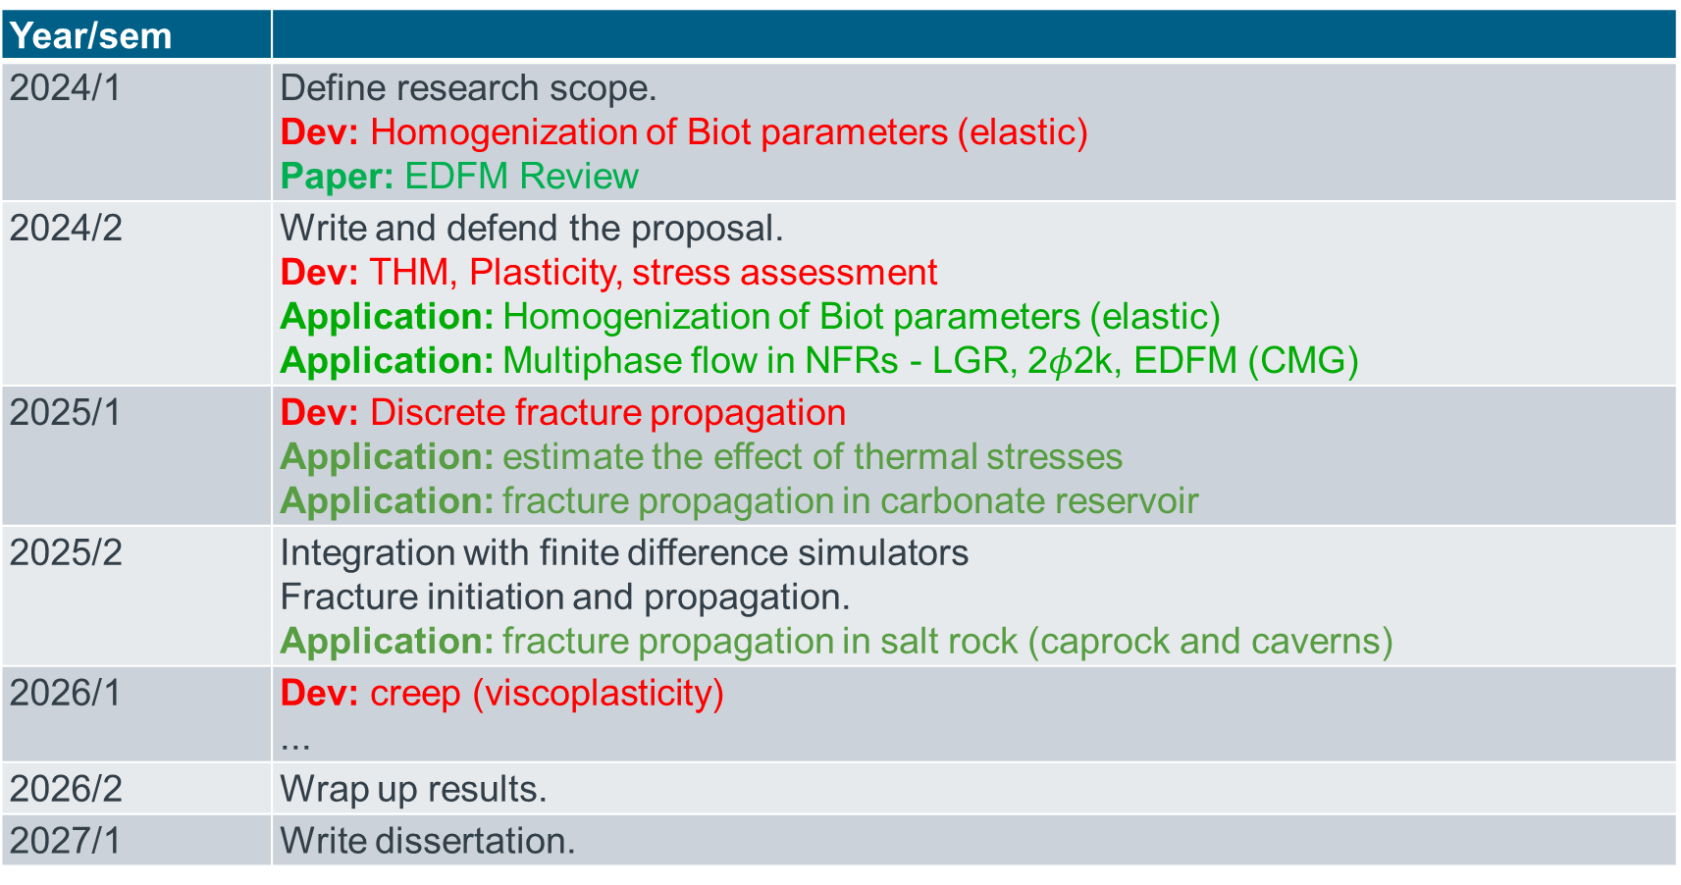
Timeline
Year/sem
2024/1 | Define research scope. Dev: Homogenization of Biot parameters (elastic) Paper: EDFM Review
2024/2 | Write and defend the proposal. Dev: THM, Plasticity, stress assessment Application: Homogenization of Biot parameters (elastic) Application: Multiphase flow in NFRs - LGR, 2$φ$2k, EDFM (CMG)
2025/1 | Dev: Discrete fracture propagation Application: estimate the effect of thermal stresses Application: fracture propagation in carbonate reservoir
2025/2 | Integration with finite difference simulators Fracture initiation and propagation. Application: fracture propagation in salt rock (caprock and caverns)
2026/1 | Dev: creep (viscoplasticity) ...
2026/2 | Wrap up results.
2027/1 | Write dissertation.

Slide 9
SOFTWARE LICENSE

Slide 10
SOME OPEN SOUCE LICENSES
PETSC
BSD - Berkely Software Distribution
LIBMESH
LGPL - Lesser GPL
FeniCS
Creative Commons Zero (CC0)
From the above, LGPL is the most restrictive, but can be used in commercial implementation.

Slide 11
Wikipedia comparison
License | Author | Latest version | Publication date | Linking | Distribution | Modification | Patent grant | Private use | Sublicensing | TM grant
BSD License | Regents of the University of California | 3.0 | ? | Permissive^{[14]} | Permissive^{[14]} | Permissive^{[14]} | Manually^{[14]} | Yes^{[14]} | Permissive^{[14]} | Manually^{[14]}
Creative Commons Zero | Creative Commons | 1.0 | 2009 | Public Domain^{[15][16]} | Public Domain | Public Domain | No | Public Domain | Public Domain | No
GNU Lesser General Public License | Free Software Foundation | 3.0 | June 2007 | With restrictions^{[31]} | Copylefted^{[26]} | Copylefted^{[26]} | Yes^{[32]} | Yes | Copylefted^{[26]} | Yes^{[32]}
https://en.wikipedia.org/wiki/Comparison_of_free_and_open-source_software_licenses

Slide 12
REFERENCES

Slide 13
